Slide 1
Predictive Analytics
Members: Colinares, Raylanne Landig, Maria Chrisva Salazar, Ma Aurora Sy, Davvid Paulo (Project Manager) Ysulan, Lorenz

Slide 2
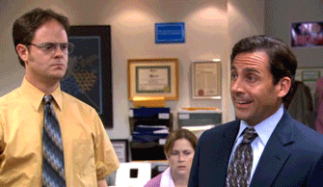
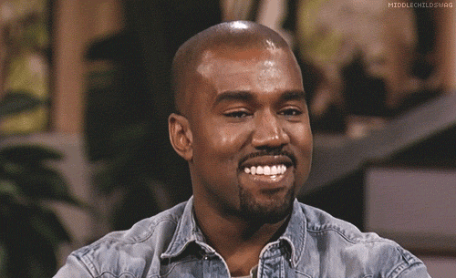
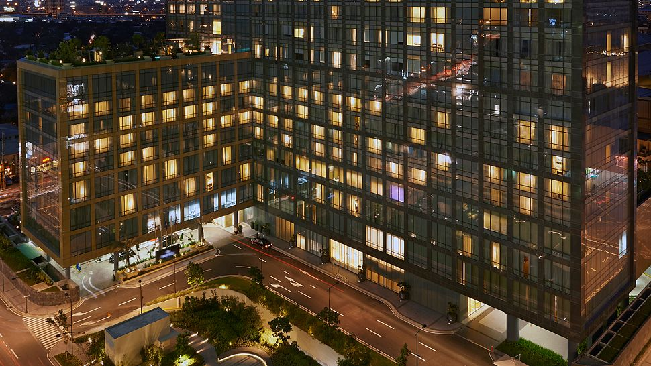
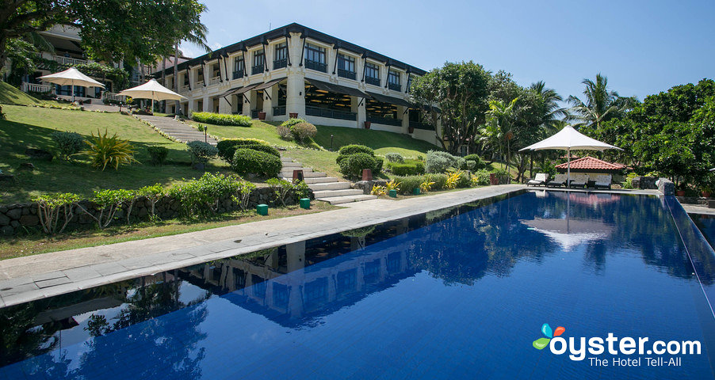
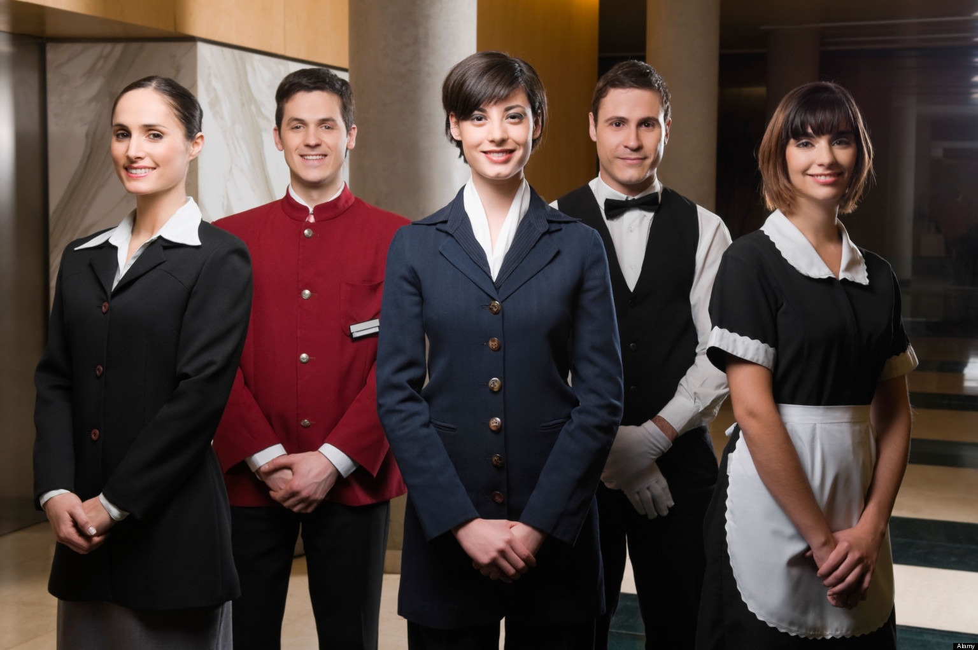

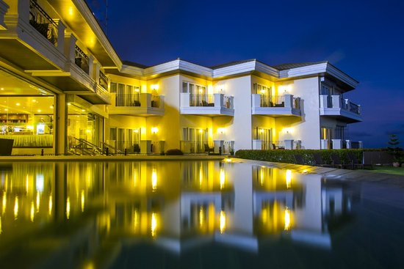
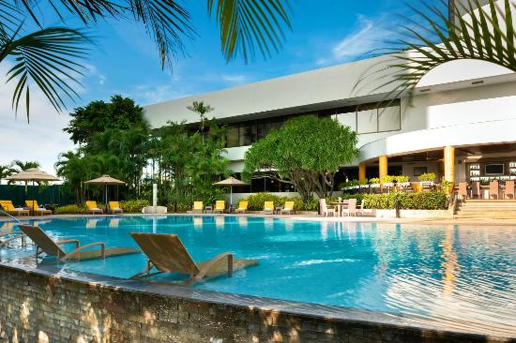
Introduction
Raffles Makati
Lake Hotel Tagaytay
Marco Polo Plaza Cebu
Notes:
There is a saying that employee represents their company well that is definitely true and that includes hotels industry, for employees are mostly who interacts with the guests and entertain the requests and not the managers. So if guests was dissatisfied during his/her stay, then there could be only 2 factors, and that is room and service. Either of those 2 can easily make guest switch from SM hotels competitors in the future and there is quite of options if they will.

Slide 3
Project Context
SM Hotels and Convention (SMHC) don’t have predictive analytics
Rely on reports
Better operation
Trend Report
Notes:
This project is about developing a Predictive Analytic System for SM Hotel and Convention (SMHC), for currently they don’t have one, but they do have several reports that they rely on for manager’s decision making, which are in their database called Opera (product of Oracle).
With the use of Predictive Analytics, the team aims SM Hotel to have a better operation, more efficient and effective services.
Trend Reports is what SM Hotel use to base if there is a need for an increase or decrease of employees on the upcoming months.

Slide 4
Purpose and Description
Employees are the front-line of the company
Hotel industry is getting bigger
Find a new hotel
Survey data
Has necessary reports
Notes:
In some industries employees represents the company and mostly the front-line of the organization because they are the one who interacts with the guest, and a dissatisfied customer can easily find another hotel if one of the employee’s gave a bad impression during his/her stay.
This is where survey comes in and those data are weightily important to the hotel to react on what changes needs to be done.
We aim to got them a better reports on what to do on the upcoming day, month and year.
Front Desk, Porter, Concierge, Housekeeping, Room Service, Kitchen Staff etc

Slide 5
Objective
Main Objective:
To develop an automated Predictive Analytics system for SM Hotels and Conventions that would retain a great level of efficient and effective service of their organization.

Slide 6
Objective
Specific Objective:
To analyze the survey results and base there to come up with suggestions on what should be retained and changed, so that managers can have a clearer picture on what aspect to improve
To provide the decision makers a report monthly and yearly basis
To be able to dig deeper on the complains of the guest

Slide 7
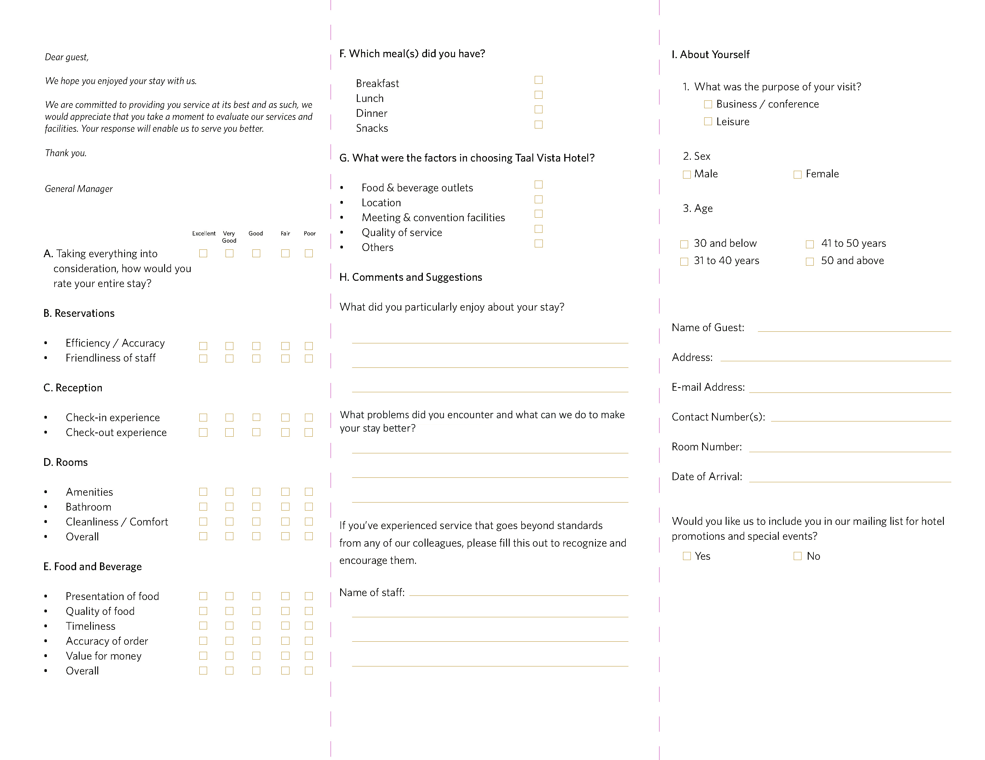

Slide 8
Scope and limitation
Create a predictive analytics for SM Hotels and Conventions
Administrator manages users role
Should be able to tell what the problem is
Should be able to suggest on what to do regarding the problem
Income and expense are irrelevant
Notes:
The study is about creating a predictive analytics system for SM Hotels and Conventions. Users are able to read the reports as long as system administrator have registered them in the system. The focus would be the employee performance, on what to retain to keep the efficiency and effectiveness of the normal operation of the company, we base this from the survey results. Anything about income and expense of the organization are considered insignificant for survey results is our basis and this does not contain income and expense. Output should be able to suggest a solution for the complains and to be able to tell the cause of those complain. Reports are submitted on monthly basis.

Slide 9
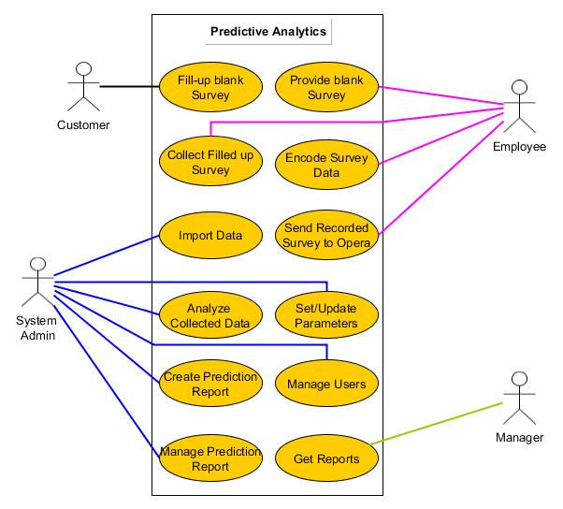
Use Case Diagram

Slide 10
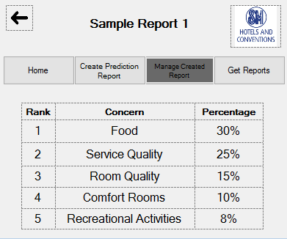
Sample Report

Slide 11
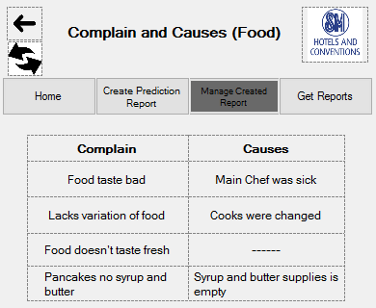

Slide 12
